Slide 1
Care of the Dying for non-registered practitioners
Endorsed by Kent and Medway COVID-19 Response Group August 2020 – updated Dec 2020

Slide 2
Joining in!
Keep mute on unless asking question
Please remember to anonymize when quoting examples/experiences.
Thinking pauses
Zoom thumbs up sign
Zoom chat
Single word answer
3 key words
Ask a question as briefly & simply as can!
Send in any extra names if more than one person on the device education@ellenor.org
Give it a go!
Notes:
Introduce yourself and then invite participants to introduce themselves via the chat button.
Microphones on mute to avoid feedback and interruptions but please unmute to ask a question or to answer any of ours.
Please can you all go on the Chat button to say Hi or where you are from on the chat button to practice and introduce yourselves.
While we just wait for any others to join us
If there are more than one person logged on please send names to education@ellenor.org or add them in the chat box here so we can send out certificates
Thank you

Slide 3
What will be covered
Aim of session is to increase confidence in caring for someone in the last days and hours of life
Outcomes
Increase awareness of resources to support care in the last days & hours of life
Explore ways to overcome challenges of COVID 19 when communicating with the patient & family
Discuss own role using a holistic approach to maintaining comfort at end of life
Consider the importance of compassion for patient, family and self
Recognising dying is covered in another Zoom session.
Please note any COVID 19 advice is evolving and subject to change.
Remember to keep up to date with organisational guidance and policies

Slide 4
What do we mean by a good death?
Take a moment to think about this.
What does this mean to us?
What does this mean to our patients / residents?
What does it mean to their families?
Lets Discuss !
This Photo by Unknown Author is licensed under CC BY-SA
This Photo by Unknown Author is licensed under CC BY-NC-ND

Slide 5
Resources to help
Useful poster
to inform your
colleagues
Leadership Alliance for the Care of Dying People (2014)
Link at end of presentation

Slide 6
Link at back of presentation

Slide 7
National Institute for Health & Care Excellence Care of dying adults in the last days of life (NICE 2017)
Take a look!

Slide 8
Symptom Control and Care of the Dying Patient: Palliative Care Guidelines
https://ashford.referralsupport.co.uk/wp-content/uploads/2020/04/Kent-and-Medway-symptom-control-guidelines-6th-edition.pdf

Slide 9
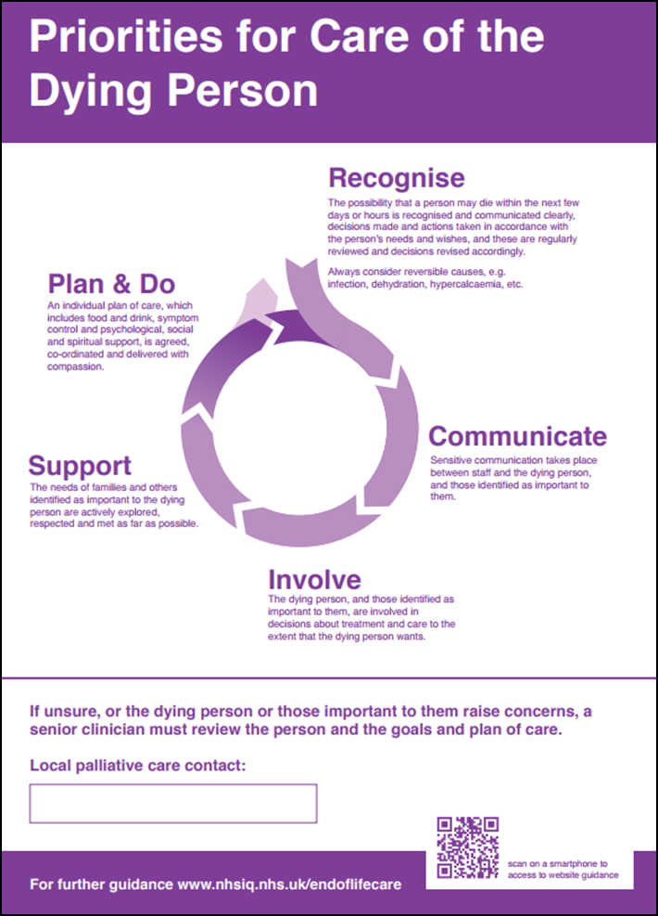
Recognise
What key points do you remember from the last session (recognising dying)?
Not always easy
Consider reversible causes
Check person’s wishes
Documentation
See Zoom timetable for further sessions

Slide 10
Communicate
How do you speak to families?
What do we mean by sensitive communication?
“I can make the last stage of my life as good as possible because everyone works together confidently, honestly and consistently to help me and the people who are important to me, including my carer(s).”
NPEoLCP 2015

Slide 12
A few key points
Do
Don’t
Allow time & listen
Be honest
Explore cues
Ask open questions
Be aware of body language (not easy with PPE)
Make eye contact
Empathise
Use pauses & silence
Remember to include the family
Be aware of challenges of not being able to speak face to face
Don’t rush the person
Don’t avoid the truth
Don’t look busy even if you are rushed off your feet!
Don’t sympathise.
Don’t give false reassurances
Don’t use jargon

Slide 13
Involve
How do you involve the dying person & those important to them in decisions about treatment & care?
How does the person & those important to them
wish to be involved?

Slide 14
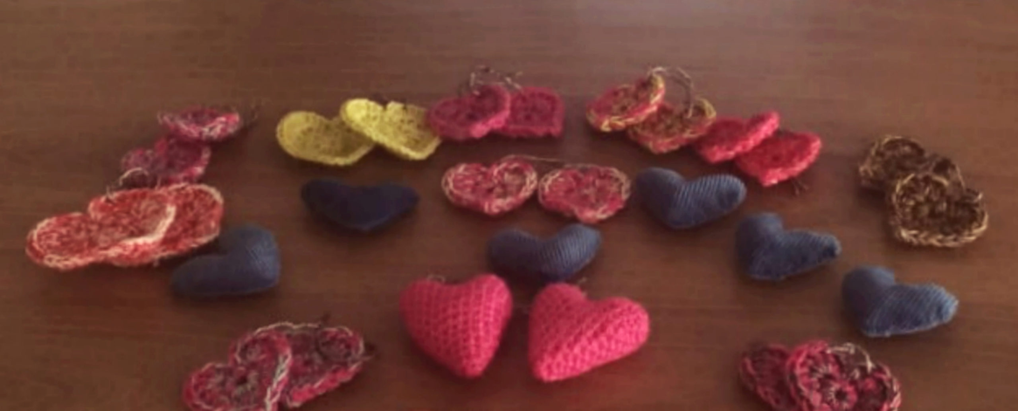
Support
One idea - Matching Hearts
How are you supporting needs of the family?
What changes have you had to make?
https://www.pilgrimshospices.org/news/pilgrims-care-team-hope-to-capture-matching-hearts-for-hospice-patients/

Slide 15
Principles of good symptom (comfort) management
Think of a patient you have recently cared for and try and capture some of the key points that helped maintain comfort when they were dying

Slide 16
Care of the dying person
Remember good communication skills are essential
Person centred approach
Consider patient wishes
Symptom control (relief of pain & other discomforts)
Always use a holistic approach & consider physical, emotional, psychological, social, spiritual, cultural & religious needs
Support the person to eat & drink as long as they wish to do so
Team communication and ask for help / advice if needed (may need to talk with GP, community nurse. Hospice etc.)
Tell patient & family what is happening in straightforward language

Slide 17
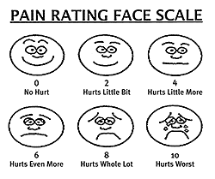
Pain management
What comfort measures can you do to help relieve pain in someone who is dying?
Think of a patient you are caring for who has pain.
How are you assessing the pain?
How are you managing the pain?
What non drug options are working?
How are you measuring the effect of your interventions?
How often are you reviewing?

Slide 18
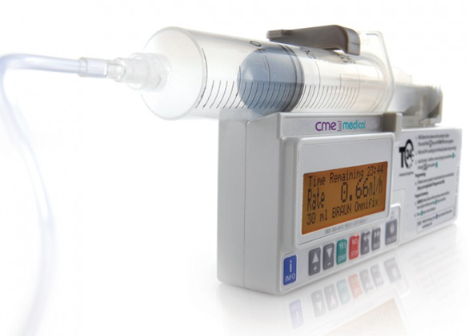
Comfort measures for pain
Remember pain is what the person says it is (we cannot feel it)
Good assessment is needed. Use an assessment tool (pain chart)
Remember holistic approach. Pain is not just physical. Explore their concerns
Try non-drug options that help (relaxation, music, warmth etc.)
Pain relief (analgesia) needs to be given regularly & on time
Make sure sufficient medication prescribed for any breakthrough pain. As regular dose goes up, the as required (prn) needs to go up too
Beware of constipation
Simple explanation to patient & family
Seek advice if needed (local hospice team)
Review – review - review
Just in case medication ready

Slide 19
Comfort measures for nausea & vomiting
Think of a patient you have who is currently
experiencing nausea or vomiting (or when you last cared
for someone with this symptom)
How are you assessing this?
How are you managing the symptom?
What non drug options are helping?
How are you measuring the effect of your interventions?
How often are you reviewing?

Slide 20
Comfort measures for management of nausea & vomiting
Reverse the reversible if appropriate
Try non-drug options (position, good mouth care)
Give the most suitable drug by the most suitable route (seek advice if needed from local clinical / hospice team)
May need injection if vomiting
Consider syringe driver if vomiting persists
Simple explanation to patient & family
Review – review - review
Just in case medication ready

Slide 21
Comfort measures for managing breathlessness
Check COVID 19 guidelines for patients affected otherwise follow as below:
Treat reversible causes where appropriate
Explore fears/ concerns. Provide simple explanation & reassurance
Try non drug options (avoid fans at present. Instead open window)
Position change, good mouth care, non restricting bedclothes
Seek advice from local clinical teams / hospice as low dose morphine may be helpful
Simple explanation to patient & family
Review – review - review
Just in case medication ready

Slide 22
Comfort measures for management of respiratory secretions
Think of a patient who is experiencing noisy secretions (or when you last cared for someone with this symptom)
How are you assessing this?
How are you managing the symptom?
What non drug options are helping?
How are you measuring the effect of your interventions?
How often are you reviewing?
What changes are being made due to COVID 19?

Slide 23
Comfort measures for managing respiratory (noisy) secretions at end of life
Good assessment is needed as it is important to check this is noisy secretions (death rattle) from pooling of secretions at back of throat when someone is dying and unable to clear by swallowing or coughing
Any earlier secretions check on how to manage in case corrective measures may help
Try non drug options
Repositioning can be very helpful
Avoid over hydration
Communication with family to help understand and manage distress this causes
Background music or TV can help distract sound
Have anticipatory medications ready
Seek advice from local clinical teams / hospice
Just in case medication ready

Slide 24
Comfort measures for managing restlessness at end of life
Think of a patient who is showing signs of restlessness
(or when you last cared for someone with this symptom)
How are you assessing this?
How are you managing the symptom?
What non drug options are helping?
How are you measuring the effect of your interventions?
How often are you reviewing?

Slide 25
Key points for managing restlessness
Patients may become restless in the last few days and hours of life
Avoid unnecessary investigations, however it is very important to consider any causes which may be easy to treat
May have a full bladder or be in urinary retention
May be constipated and may be appropriate to relieve
May be too hot or cold
May be in pain (is syringe driver working?)
Drug toxicity (may need reducing or changing)
Anxiety / distress ( communication / soothing familiar music may help)
Just in case medication ready
Simple explanation to patient & family
Seek advice from local clinical teams / hospice
Regular review
Just in case medication ready

Slide 26
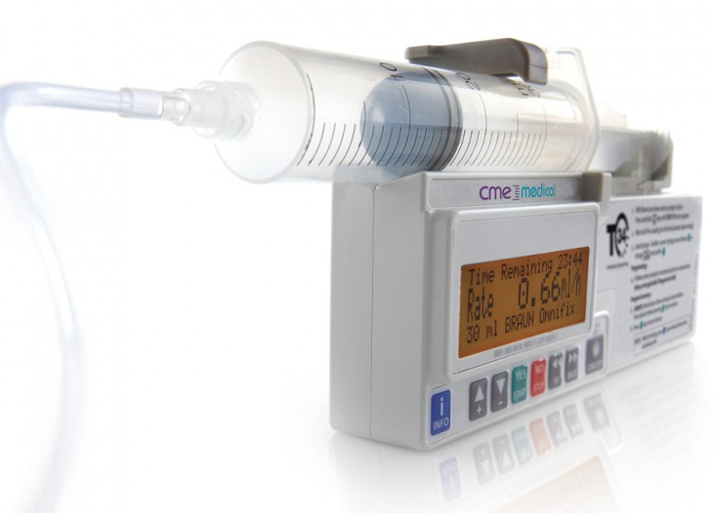
Overview of medications in the last few days and hours of life
The key here is to be prepared
Think anticipatory planning
Think Just in Case medications
Check syringe driver at the ready
Check training up to date
Read through booklet for syringe driver drug information (pages 10, 11 & 20 – 22)
Seek advice from local clinical teams / hospice as needed
Be prepared and Plan ahead

Slide 27
Care After Death
Care does not stop at death……
What else do we need to consider?
Lets Discuss !

Slide 28
Care After Death
Considerations –
Verification and certification of death
Paperwork completed
Involvement of the coroner. Inform families if this is a possibility.
Supporting the family
Preparing for transfer to mortuary/ undertakers
Check up to date COVID 19 guidance

Slide 29
Care after death guidance (Hospice UK 2015)
Remember to check latest COVID guidance

Slide 30
Do not forget to take care of yourself!!

Slide 31
References
Leadership Alliance for the Care of Dying People (2014) Priorities for Care of the Dying Person https:/
https://webarchive.nationalarchives.gov.uk/20160805125329/http://www.nhsiq.nhs.uk/media/2483136/pfcdp-leaflet2.pdf /webarchive.s.uk/media/2483136/pfcdp-leaflet2.pdf
Video: Coronavirus: How to care for the dying and the terminally ill - BBC Newsnight -u tube
Poster https://webarchive.nationalarchives.gov.uk/20160805125321/http://www.nhsiq.nhs.uk/media/2483924/pfcdp-poster.pdf
Hospice UK (2015) Care After Death. Guidance for staff responsible for care after death. https://www.hospiceuk.org/what-we-offer/publications?cat=72e54312-4ccd-608d-ad24-ff0000fd333
Marie Curie resources https://www.mariecurie.org.uk/professionals/palliative-care-knowledge-zone/final-days/recognising-deterioration-dying-phase
NICE (2017) Care of dying adults in the last days of life https://www.nice.org.uk/guidance/ng31
https://www.nice.org.uk/guidance/ng31
Referral Support Tool http://ashford.referralsupport.co.uk/referrals/verification-of-expected-death-voed/

Slide 32
Remember even if most palliative care workers look calm and confident when working with end of life, they are working hard to listen carefully & tap into all the resources they have. We hope these resources will help you. Remember you are doing an amazing job Well done! Keep well and safe! Thank You

